Slide 1
Tumour Modelling Part I: An introduction to Cancer
Dr. David Robert Grimes
E-mail: d.r.grimes@qub.ac.uk
Twitter: @drg1985
Queen’s University Belfast, January 8th 2018

Slide 2
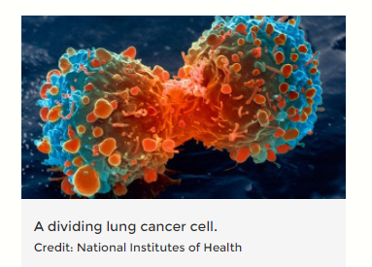
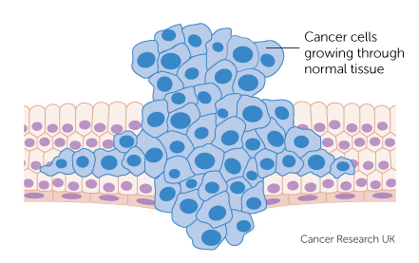
What is Cancer?
Cancer is the name given to an entire family of disease, characterised by abnormal cell division and spreading.
There are over 200 known cancer types, all of which have various properties, with widely varying prognosis and treatment
But what properties
define cancer?
How does it differ
from healthy tissue?

Slide 3
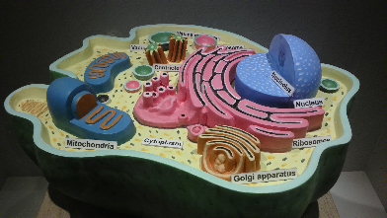
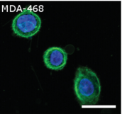
The Cell
Cell comes from the latin ‘cella’ – a small room!
In biology, they are considered the basic biological unit of all life.
By this, we mean a cell is the smallest unit that can replicate independently.
Cells contain the requisite information to make new cells, and contain the hereditary information for regulating cell function
Cells can be of a specific type, and collections of cells can form tissues. We will revisit this later when radiation biology is introduced.
First observed by Robert Hooke in the 1600s.
Wikimedia commons – Structure of Anima Cell (2014, Royroydeb)
Animal cells (Breast cancer line) showing cell nucleus in blue and membrane in Green. Grimes et al 2016, doi:10.1371/journal. pone.0153692

Slide 4
The Hallmarks of Cancer
Surprisingly, a universal definition of cancer has been rather difficult to elucidate !
Perhaps the most accepted definition comes from a seminal paper by Douglas Hanahan and Robert Weinberg (2000).
In it, they outline 6 ‘Hallmarks of cancer’, common to all tumours.

Slide 5
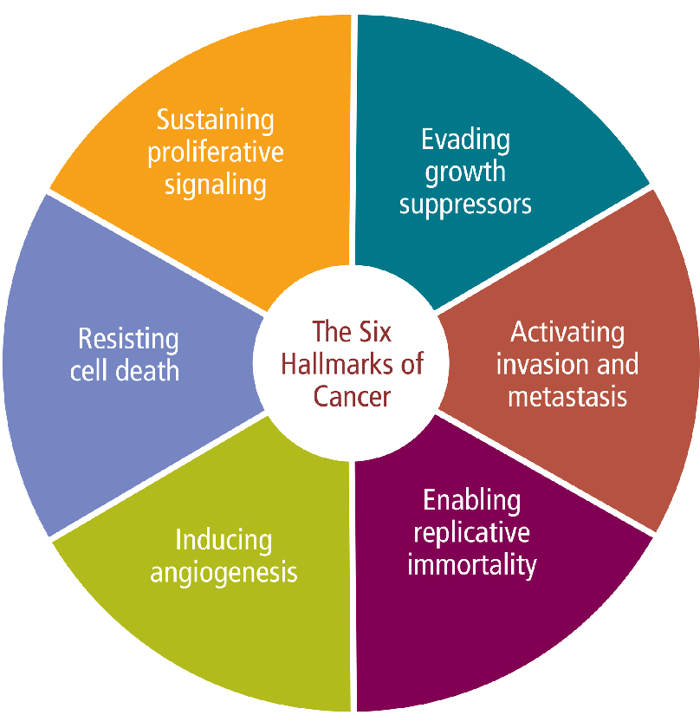

Slide 6
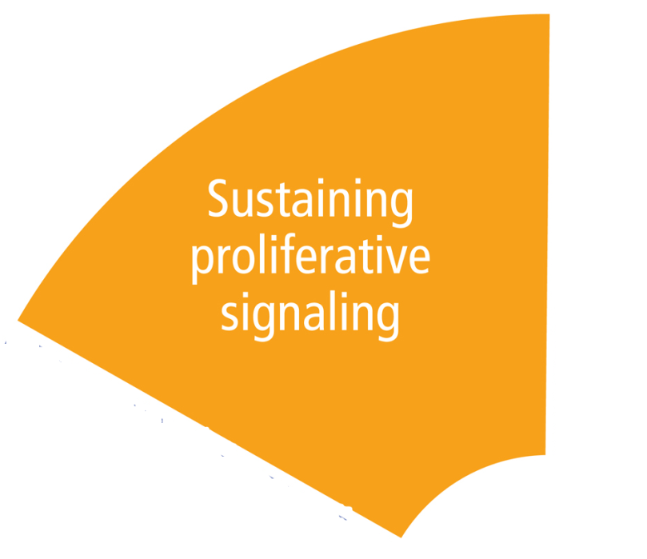
1. “Cancer cells do not need stimulation from external signals (in the form of growth factors) to multiply.”
Healthy cells require other hormones and signalling molecules to tell them when to grow and divide.
Cancer cells produce these signals themselves, the process of ‘autocrine signalling’.
This is achieved either by permanently activating signalling pathways or destroying negative feedback ‘off’ switches.
Cell division in healthy cells is tightly controlled – in cancer cells, controlling proteins are altered and division is deregulated.

Slide 7
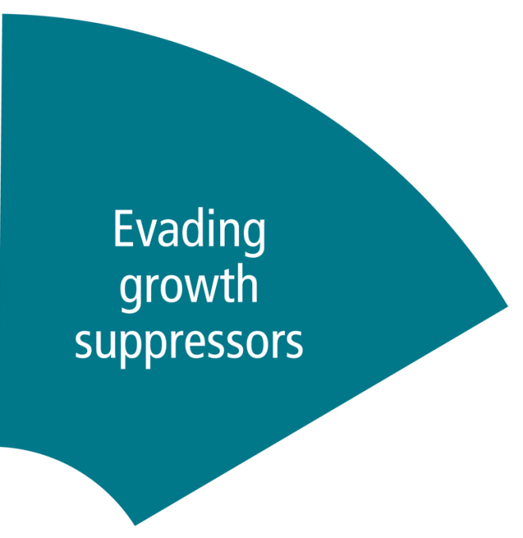
2. “Cancer cells are generally resistant to growth-preventing signals from their neighbours.”
In healthy tissue, cell division is tightly regulated and cells signal to each other.
Cell division is regulated by ‘tumour supressor genes’. These halt division if DNA is damaged, or other problems are detected.
In cancer, this breaks down, even when severe abnormalities present.
Contact inhibition is also diminished, so cells grow regardless of their environment!

Slide 8
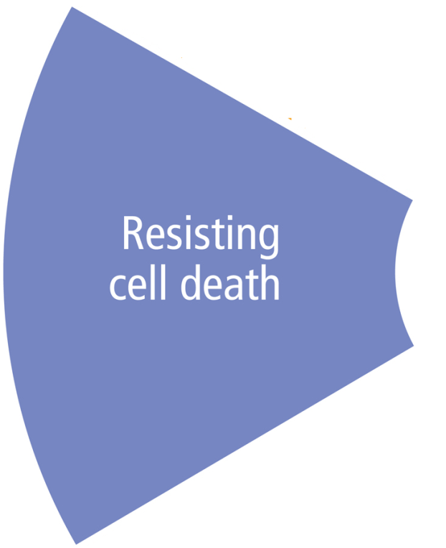
3. “Apoptosis is a form of programmed cell death (cell suicide), the mechanism by which cells are programmed to die in the event they become damaged. Cancer cells are characteristically able to bypass this mechanism.”
Defective cells should undergo a process of programmed cell death so that they do not pass on defective instruction.
Tumour cells avoid this instruction, as their signalling is already impaired.
As a result, cancer cells do not self-destruct when requested, despite their obvious damage.

Slide 9
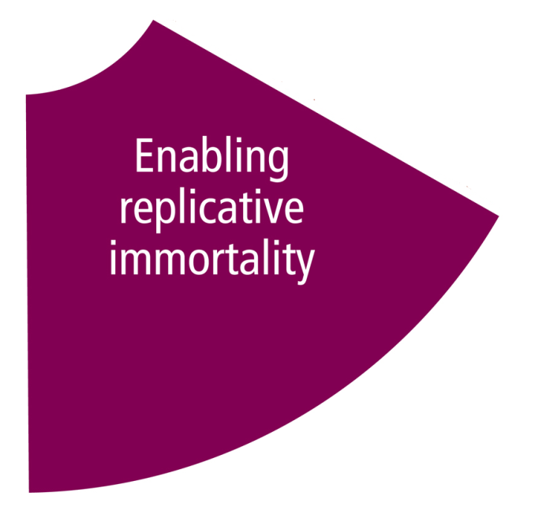
4. “Non-cancer cells die after a certain number of divisions. Cancer cells escape this limit and are apparently capable of indefinite growth and division (immortality). But those immortal cells have damaged chromosomes, which can become cancerous.”
Mammalian cells can only reproduce a certain number of times (typically 60-70).
This is known as the HAYFLICK LIMIT, and is tightly regulated by telomeres – upon each doubling, telomeric DNA shortens until it is too short to divide again.
Cancer cells cheat – they can upregulate their telomeres, and become immortalized.
Most tumour cells are immortalized.

Slide 10
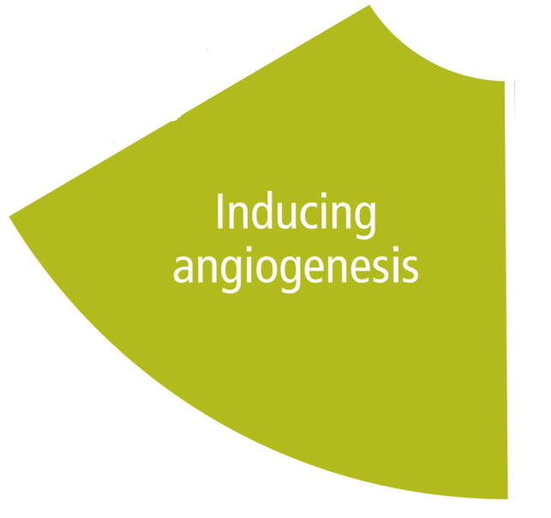
5. “Angiogenesis is the process by which new blood vessels are formed. Cancer cells appear to be able to kickstart this process, ensuring that such cells receive a continual supply of oxygen and other nutrients.”
In healthy tissue, blood vessels are neatly ordered to supply oxygen and other nutrients to tissue.
Cancer cells exploit the normal mechanisms to create new blood vessels.
These are chaotic and poorly structured – there may be a lot of blood vessels in a tumour, but it tends to be poorly perfused.
This leads to regions of severely hypoxic tissue – an issue we will return to later.

Slide 11
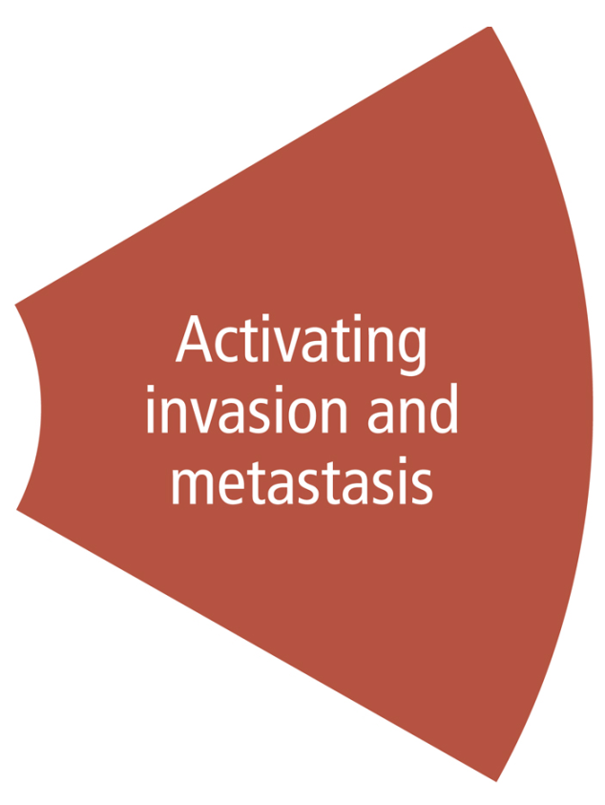
6. “Cancer cells can break away from their site or organ of origin to invade surrounding tissue and spread (metastasize) to distant body parts.”
This is perhaps the most distinctive property of cancer, and distinguishes between benign and malignant tumours.
Cancer cells can invade other tissues – locally initially, and eventually, they can evolve to survive far from their site of origin.
This is perhaps the most dangerous property of cancer too.

Slide 12
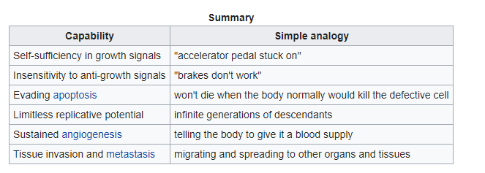
…the Wikipedia page offers some nice analogies for these properties!
Wikipedia “The Hallmarks of Cancer” (accessed January 2018)
…in 2010, Hanahan and Weinberg offered some further hallmarks….

Slide 13
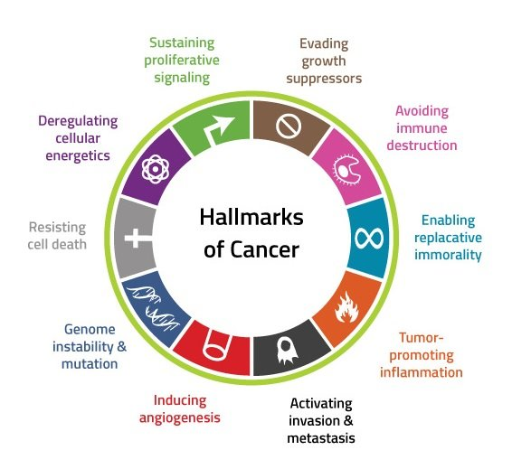
The hallmarks "Deregulated metabolism", "Immune system evasion", "Genomic instability" and "inflammation" were added in 2010. We will comment on them briefly here, but for our purposes the 6 major hallmarks should suffice for these lectures…

Slide 14
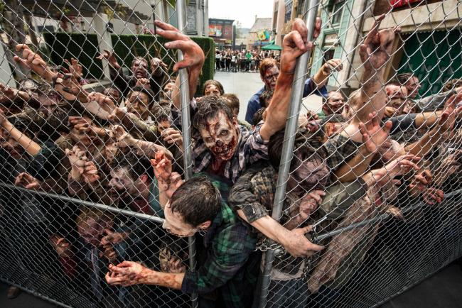
…Effectively immortal, eager to spread, and deaf to the protestations of others, Cancer cells are a little like a Zombie hoard!

Slide 15
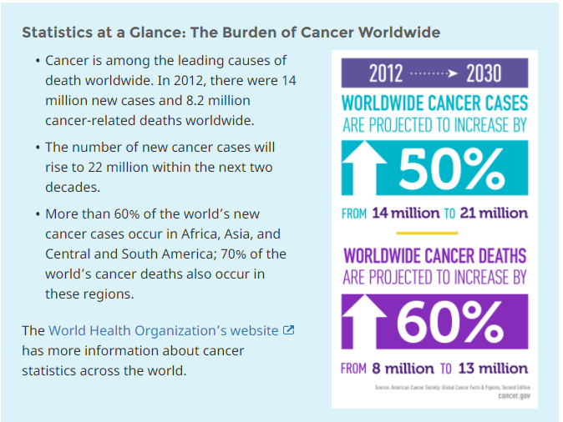
Cancer incidence
Taken from Cancer.gov

Slide 16
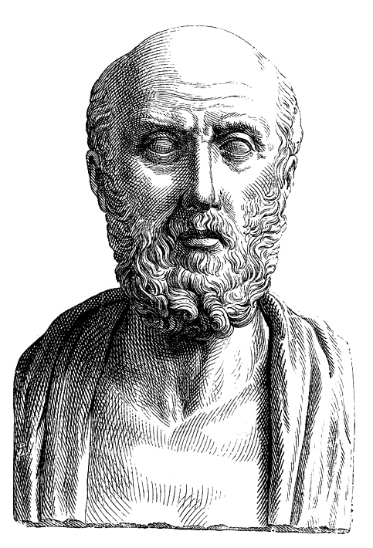
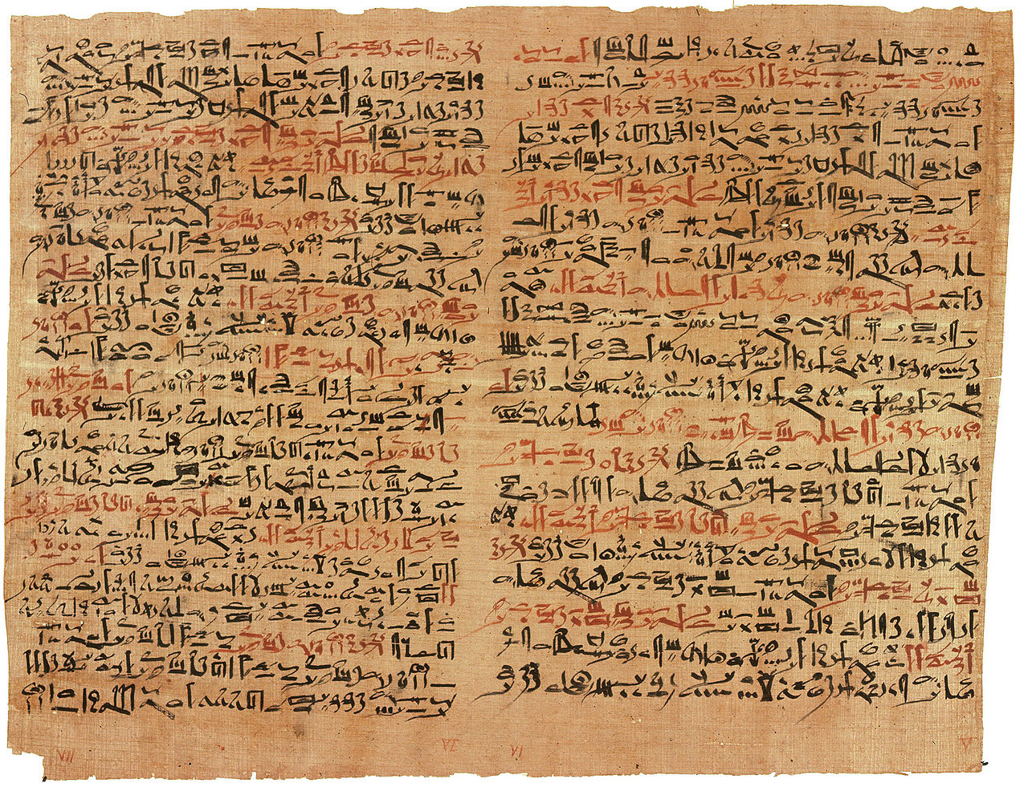
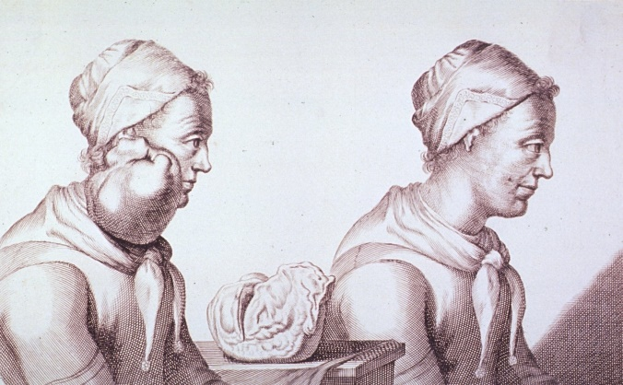
Cancer is not a new illness..
Observation by Hippocrates : crab-like protrusions
Edwin Smith Papyrus (about 3600 years old)
Tumour removal - 1689

Slide 17
Image courtesy of Prof. Mike Partridge (Taken in London C. 1908)
….So have rates gone up, and why?

Slide 18
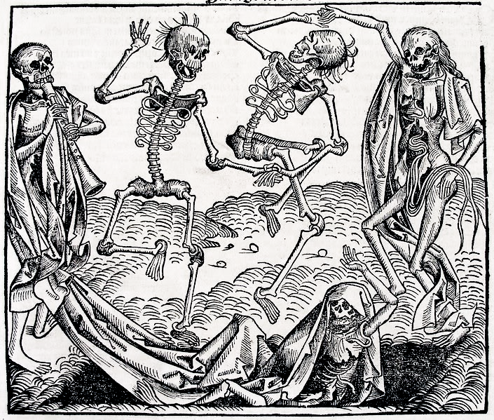
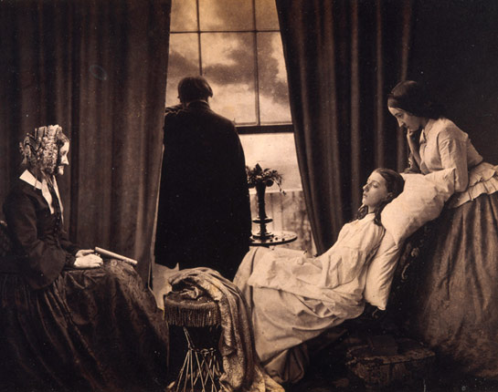
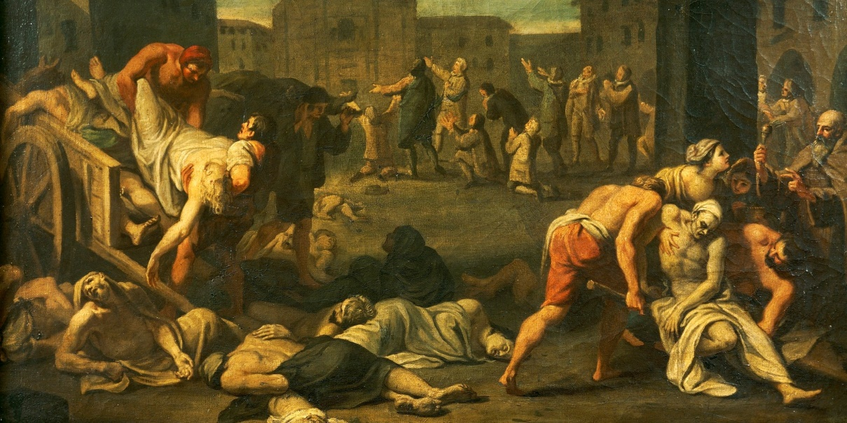
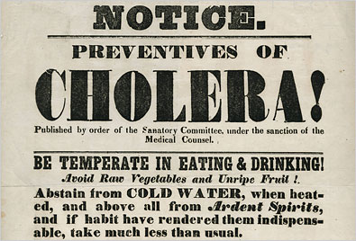
….yes, MAINLY BECAUSE WE HAVE LESS OF THIS…

Slide 19
Cancer causes
Cancer doesn’t arise in isolation – it evolves from a series of mutations, induced by DNA damage, or arising from replication errors, or cellular insult.
We have also evolved many mechanisms for DNA repair and tumour avoidance, and these are remarkably effective.
With time and repeated damage however, cells can acquire enough mutations to become cancerous.

Slide 20

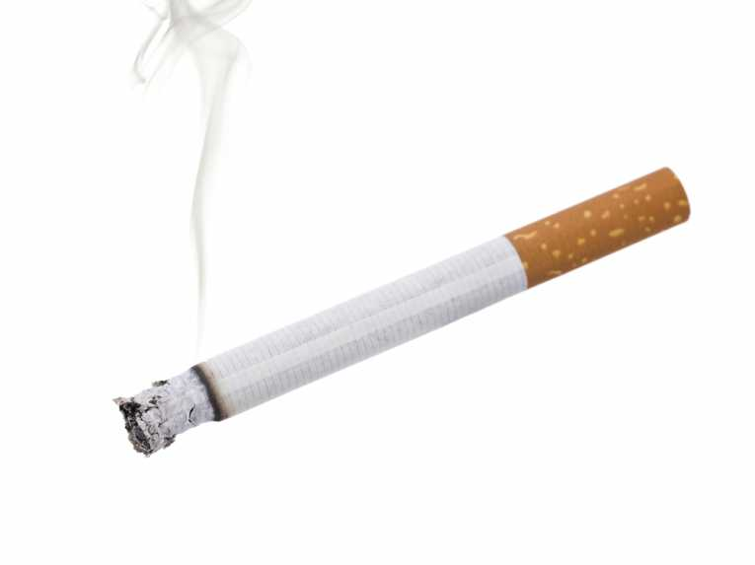
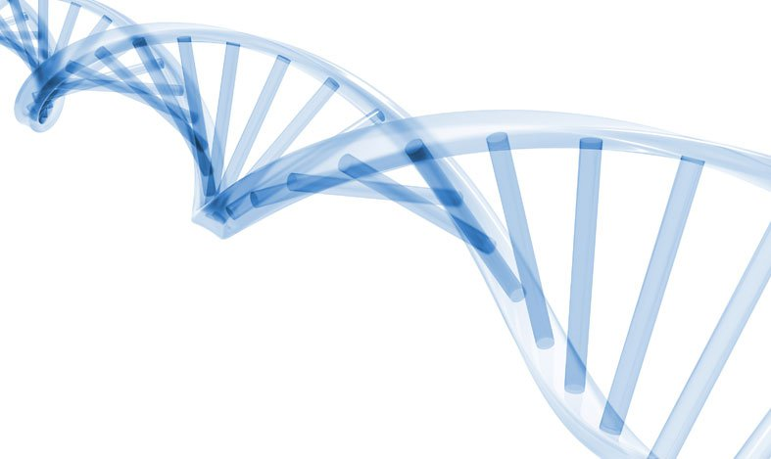


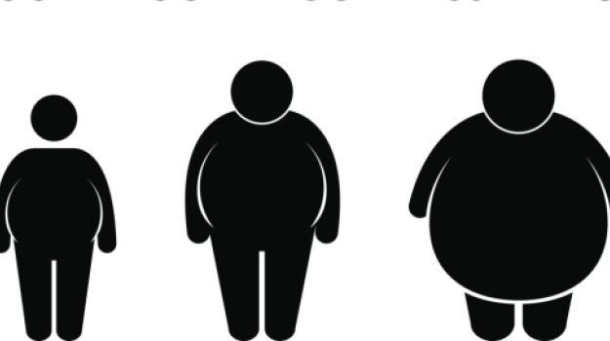
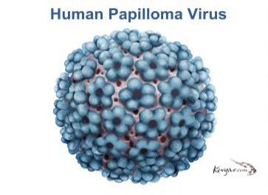
The causes of cancer – a rogue’s gallery
Cancer is an emotive subject, and an inherently complex family of illnesses.
Whilst we can take very pro-active steps to reduce our chances of having cancer, there is still a stochastic element to the illness.
We known of many factors that modulate our risk…..
….cancer has a large stochastic element …

Slide 21
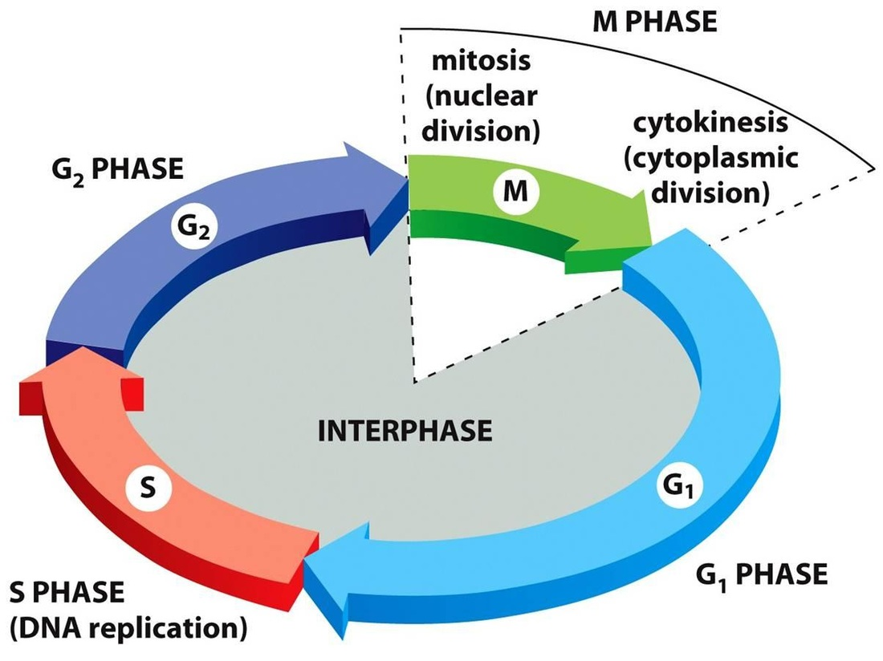
The cell cycle
G1 (gap 1) - Cells increase in size, G1 checkpoint control mechanism readies cell for DNA synthesis.
S (synthesis) – DNA replicated.
G2 (gap 2) - Cell continue to grow, G2 checkpoint control mechanism readies cells for M-phase.
M (mitosis) - orderly division into two daughter cells.
G0 (gap 0) - Cell leaves cycle and stops dividing (quiescence).

Slide 22
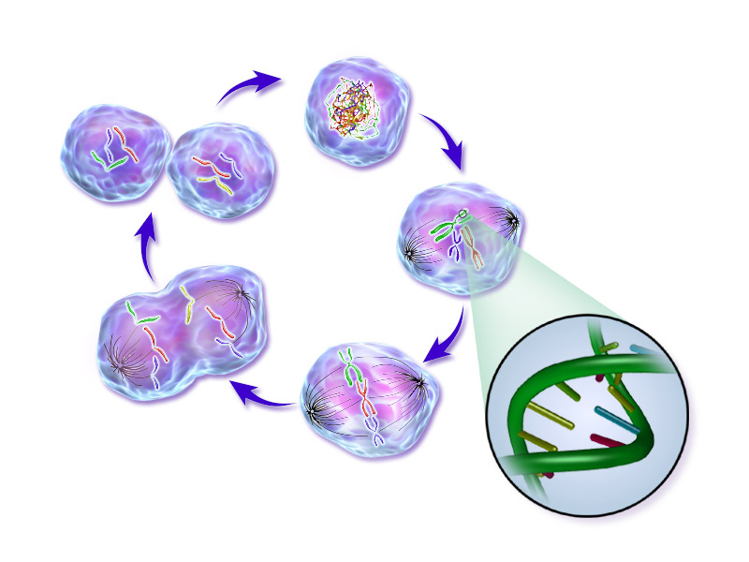
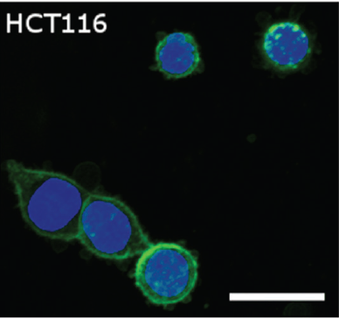
Grimes et al 2016, doi:10.1371/journal. pone.0153692
Wikimedia commons - Normal Cell Life Cycle.png (2016, BruceBlaus)

Slide 23
The tumour microenvironment
Tumour cells do not (generally) grow in isolation – they exist as part of a complex ecosystem.
Cells also require nutrients to thrive, and we shall look at this in some detail.

Slide 24
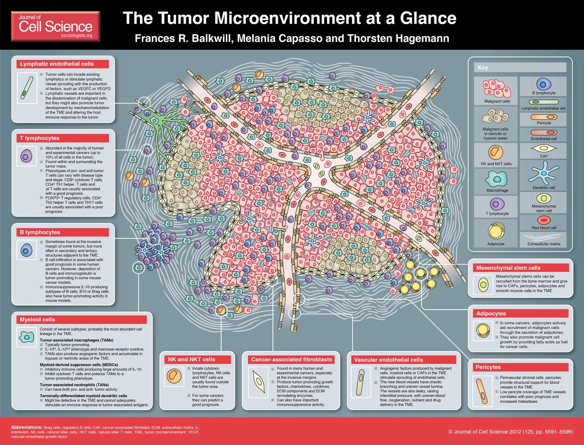

Slide 25
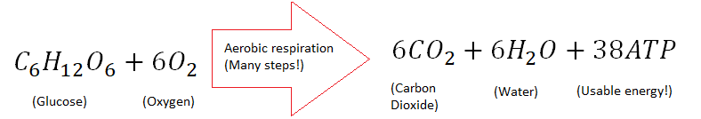
Glucose in tumours
Glucose is essential for producing Adenosine triphosphate (ATP), considered the ‘unit’ of cellular energy transfer.
In healthy tissue, we tend to use aerobic respiration (with oxygen) to produce this.

Slide 26
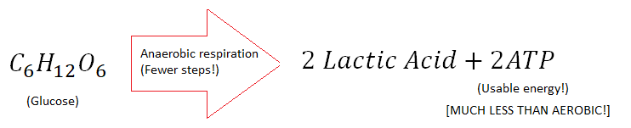
Glucose in tumours
However, in tumours, anerobic respiration becomes common. Glycolosis is upregulated.
This yields low ATP and produces a lot of lactate! Why does this occur?

Slide 27
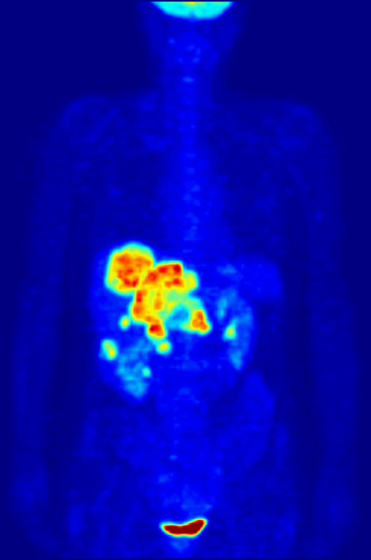
Warburg effect
Otto Warburg postulated in the 1920s that the increase in glycolosis was how cancer initially arose.
We now know this is not the cause – upregulation of inefficient respiration pathway is a consequence, not a cause, of cancer.
This might be due to mitochondria damage, or adaptation to low oxygen microenvironment of tumour, which we shall discuss shortly.
High levels of glycolosis in tumours is also the basis of FDG-PET!

Slide 28
Oxygen in tumours
Oxygen plays a seminal role in cancer.
In 1953, Hal Gray (he of the unit) and colleagues observed that tumours deficient in oxygen had markedly worse prognosis than those with ample supply. This finding has been clinically validated right up to present day.
There are many reasons for this (for full discussion, see review by Grimes, Warren and Warren, British Journal Radiology 2017) but amongst these are that cells in the hypoxic niche are subject to greater selection pressures, which drive the evolution of dangerous metastatic phenotypes.
Hypoxia also induces new blood vessel formation, creating new routes for cancerous cells to travel locally and new avenues to invade.
Crucially too, hypoxia hugely impedes the efficacy of radiotherapy!

Slide 29
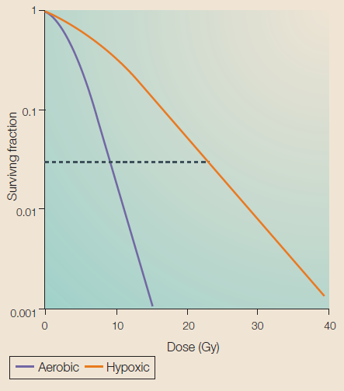
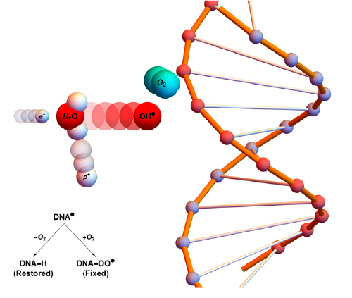
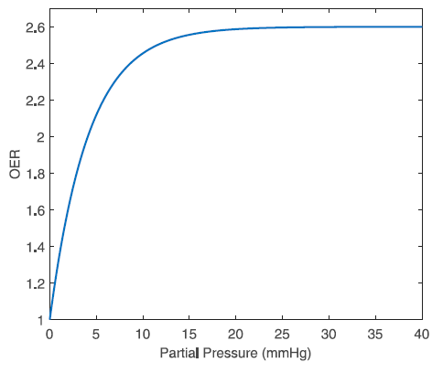
Oxygen Enhancement Ratio (OER)
From Brown and Wilson 2004 - doi:10.1038/nrc1367
From Grimes and Partridge 2015 - Biomed. Phys. Eng. Express 1 045209
From Grimes, Warren, and Warren (Br J Radiol 2017; 90: 20160939.)
….Oxygen markedly boosts therapy efficacy!

Slide 30
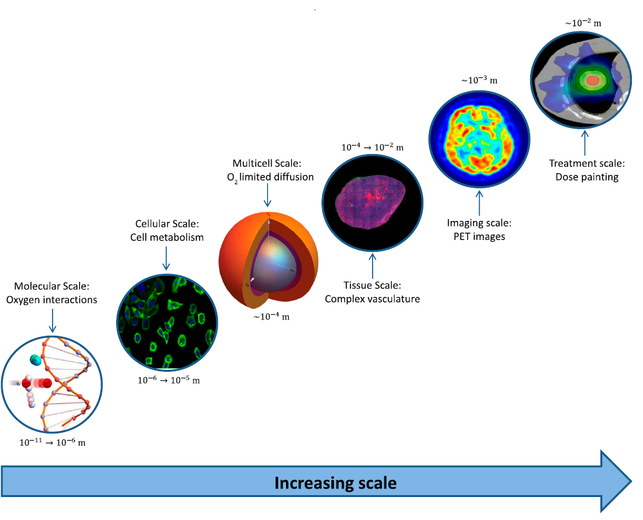
….HYPOXIA INDUCED RADIORESISTANCE IS A MULTISCALE PROBLEM…
From Grimes, Warren, and Warren (Br J Radiol 2017; 90: 20160939.)

Slide 31
The micro-vessel network
Micro-vessel networks are essential for providing cells with oxygen, and extracting waste products of respiration (such as carbon dioxide)
In healthy tissue, these are well ordered and appropriate.
But as tumours can hi-jack the signalling machinery, and send out ludacrious amounts of angiogenic growth factors.
The result is typically that tumours have a mess of tortuous vasculature.

Slide 32
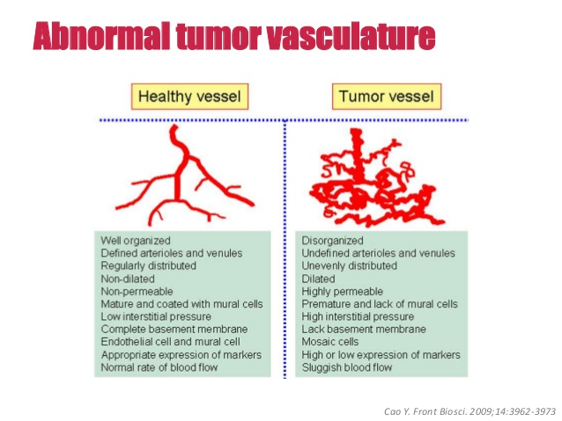
The micro-vessel network

Slide 33
“Tumours typically display highly contorted and chaotic vasculature, and these tortuous and irregular vessels lack the hierarchical arrangement of healthy vessels. In addition to this, endothelial cells in tumours tend to be abnormal and the secretion of angiogenetic growth factors encourages the formulation of bizarre vessel structures. In some instances, these micro-vessels are only perfused by plasma or simply not perfused at all, therefore despite the presence of a vessel, there may be no oxygen supplied
to the tumour region. In this environment, hypoxia can readily become dominant even when there is apparent vascular supply.”
- Grimes, Warren, and Warren (Br J Radiol 2017; 90: 20160939.)

Slide 34
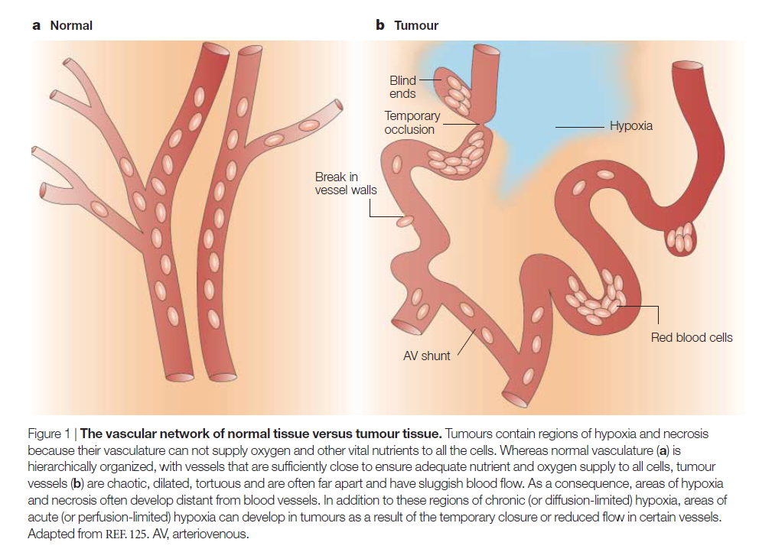
From Brown and Wilson 2004 - doi:10.1038/nrc1367

Slide 35
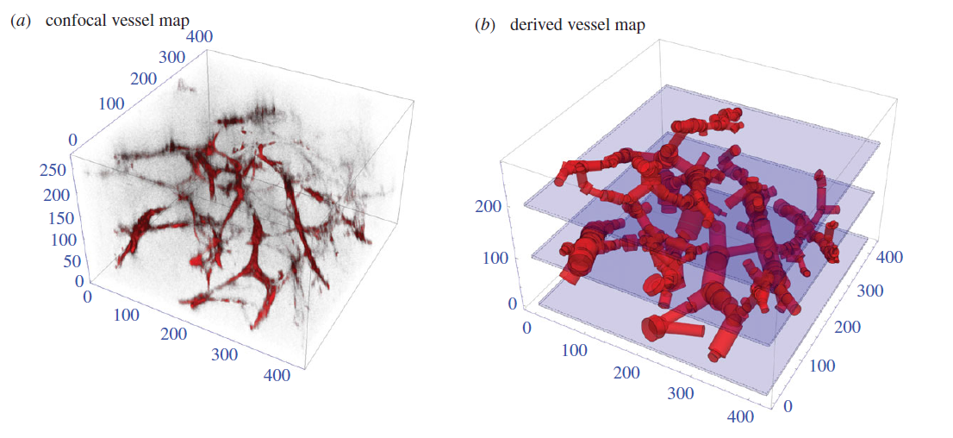
….VESSEL MAP from MC-38 MOUSE TUMOUR…
From Grimes et al 2016 doi: 10.1098/rsif.2016.0070
….This high density of vessels does not mean ample oxygen!

Slide 36
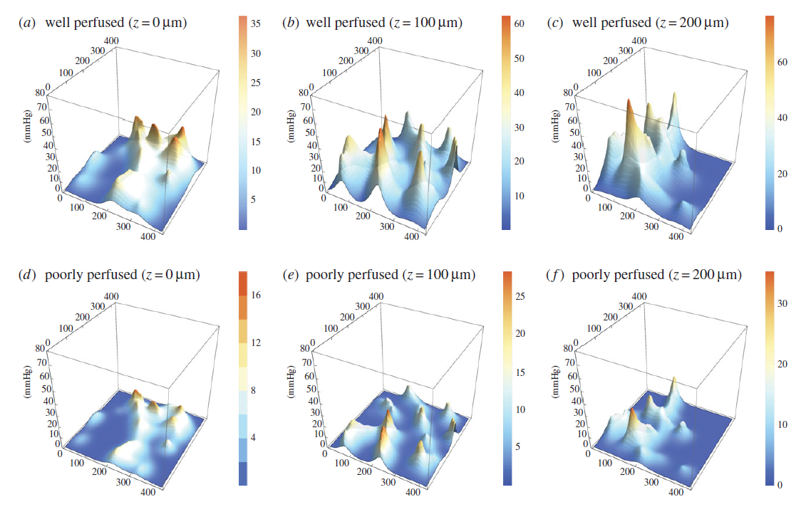
From Grimes et al 2016 doi: 10.1098/rsif.2016.0070
….This high density of vessels does not mean ample oxygen!

Slide 37
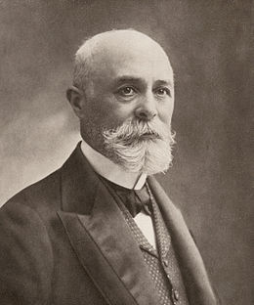
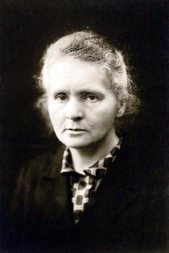
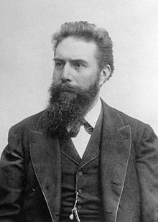
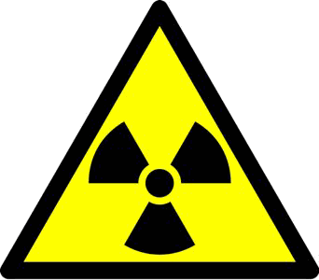

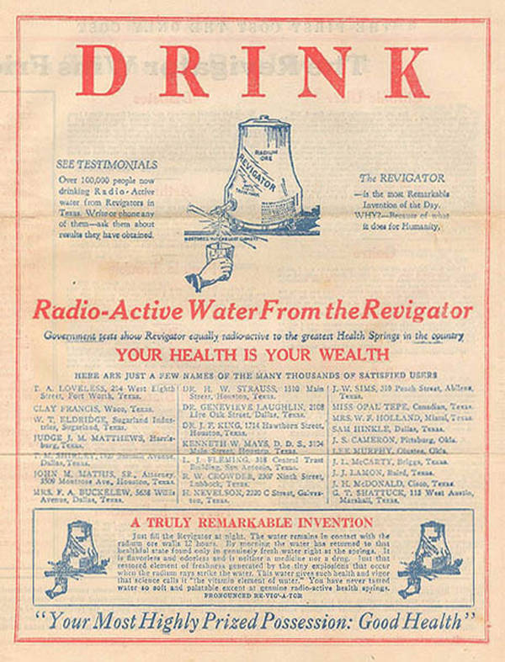
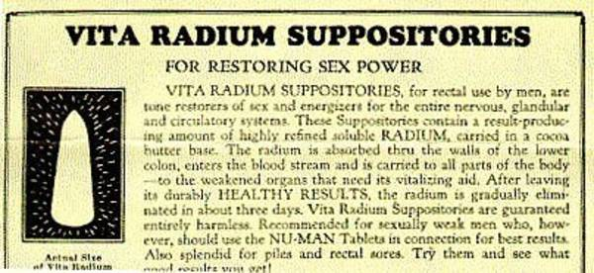
Physics in cancer research
Cancer isn’t solely the remit of biologists – quantification / modelling is vital!
Physics and physicists have long been at the forefront of cancer research
Henri Bequerel -radioactivity
Marie Curie - radioactivity
Wilhelm Rontgen – X-rays
Radiation mediated death
Radiation mediated death
Used shielding – avoided death!
Of course, radiobiological knowledge was somewhat lacking…

Slide 38
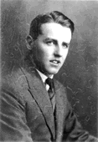

Physics in cancer research
Cancer isn’t solely the remit of biologists – quantification / modelling is vital!
Physics and physicists have long been at the forefront of cancer research
Henri Bequerel -radioactivity
Marie Curie - radioactivity
Wilhelm Rontgen – X-rays
Radiation mediated death
Radiation mediated death
Used shielding – avoided death!
Of course, radiobiological knowledge was somewhat lacking…
The field of radiobiology was pioneered by physicist Louis Harold Gray;
Investigated dose-response in radiotherapy
Examined relative biological effectiveness of different radiations
Researched effects of hypoxia and oxygen level on treatment prognosis
Unit of radiation dose is named in his honour
Louis Harold Gray

Slide 39
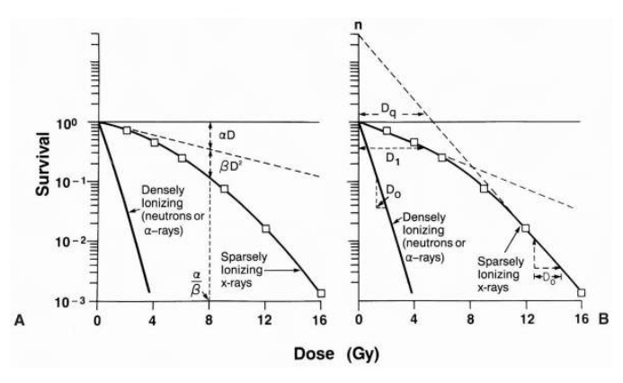
….later in the course you’ll see cell survival curves, LIKE THIS….
..This is important, and we’ll tackle it a little later on

Slide 40

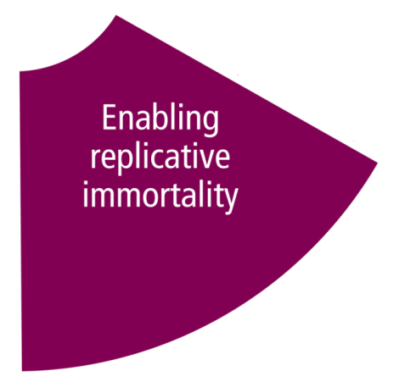


How do tumours grow?
Understanding how tumours grow gives us insight into how the disease will progress.
Ultimately this should also give us some tools to treat cancer as well – forewarned is forearmed!
Let’s recall what we know of cancer from the relevant hallmarks!
….so what form would we expect for a growing tumour?

Slide 41


Unlimited growth
If this is the case, then the volume of a tumour as a function of time, V(t), is related to the growth rate r by…
You will of course recognise this as exponential growth, and a solution is rapidly obvious! For a tumour with initial volume V0, volume is given by….
….What will this look like?

Slide 42

For early stage growth, this function captures tumours well. HOWEVER….
Let’s imagine a single spherical cancer cell, with radius of ro = 6 micron. Let’s say further that the tumours growth rate is one division per day. How would this look over 50 days?
vo = (4*pi)/3(ro^3)
r =1
……
Notice an issue?!

Slide 43

Exponential growth
Exponential growth captures early stage growth of tumours well.
But it rapidly fails to explain the long term dynamics….
More complexity needed!
From Conger and Zisikin (Cancer Res, 1983)

Slide 44
Towards tumour modelling
Why might a simple exponential model fail to capture tumour growth?
Next week’s lecture will focus on tumour modelling, and the applications of this, from history right up to present day.
We will distinguish between phenomenological models (which describe behaviours without recourse to what causes them) and mechanistic models (which try to capture underlying mechanisms) and see how these apply to cancer research and biophysics.
It is important to have some background on cancer for next week’s lecture, so please take the time to recap through some of the points introduced this week.
We’ll pick up here next week

