Slide 1
Tumour Modelling Part 2: Intro to Modelling Cancer
Dr. David Robert Grimes
E-mail: d.r.grimes@qub.ac.uk
Twitter: @drg1985
Queen’s University Belfast, January 15th 2018

Slide 2
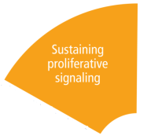
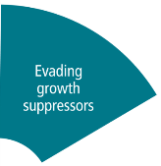
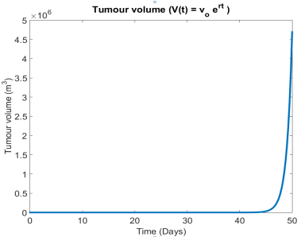
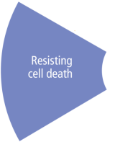
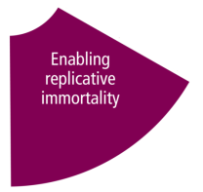
Refreshing our knowledge
Let’s pick up where we left last week. We took some of the hallmarks of cancer and tried to predict how tumours might grow…
This leads to exponential growth, as we saw last week!
SO WHY Is this not right?

Slide 3
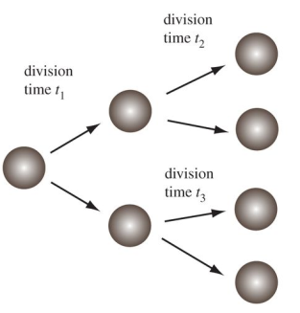
Exponential growth in biology
….well it sometimes is!
Cell division (Stukalin et al, RSIF, 2013)
E-Coli Growth (Wikimedia commons, TimVickers, 2010)

Slide 4
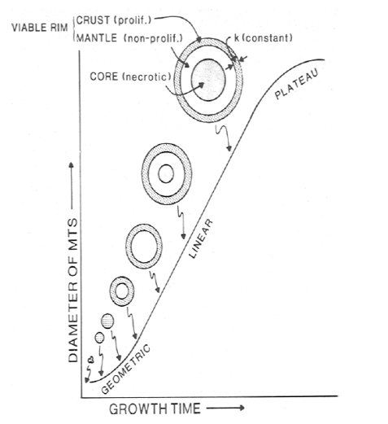
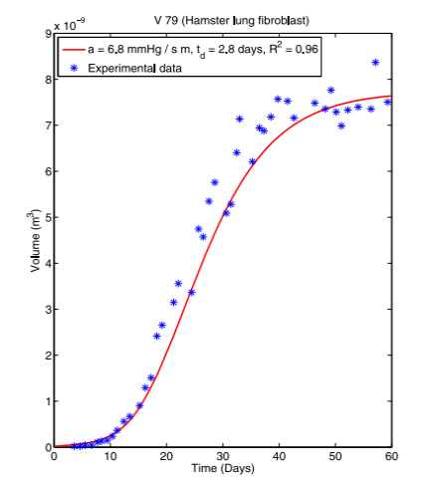
Real solid tumours
From Grimes et al 2016 (doi:10.1371/journal. pone.0153692 – Based on data by Freyer et al)
From Conger and Zisikin (Cancer Res, 1983)

Slide 5
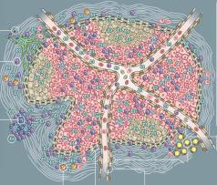
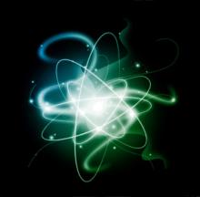
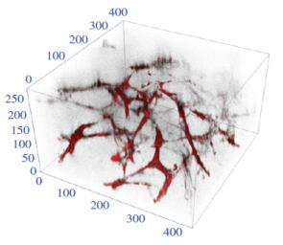
Observations
Exponential growth seems to describe early stage growth for solid or avascular tumours, but it ultimately breaks down. Why?
1. Space constraints.
3. Energy requirements.
2. Inadequate nutrients.
4. Cell death.
We need to get a little more sophisticated!

Slide 6
An important definition issue
Models can be broadly divided into two types – mechanistic and phenomenological. Here, we’ll use the definition of Hilborn and Mangel (The Ecological Detective - Confronting Models with Data, 1997)
Mechanistic models – “a hypothesized relationship between the variables in the data set where the nature of the relationship is specified in terms of the biological processes that are thought to have given rise to the data. The parameters in the mechanistic model all have biological definitions and so they can be measured independently of the data set referenced above.”
Phenomenological models – “a hypothesized relationship between the variables in the data set, where the relationship seeks only to best describe the data.”

Slide 7
An important definition issue
Mechanistic
Phenomenological
Employed when the relationship between variables is known or simple.
Directly relates an effect to a cause.
Can be used as the building block of growth models.
Can be used when a biological or physical relationship is unknown.
Describes the data observed without recourse to mechanism.
Useful when many complex processes involved, many unknowns.
Both types used in cancer research!

Slide 8
Carrying Capacity
The concept of carrying capacity is useful. Let’s take the Wikipedia definition for now…
“The carrying capacity of a biological species in an environment is the maximum population size of the species that the environment can sustain indefinitely, given the food, habitat, water, and other necessities available in the environment. In population biology, carrying capacity is defined as the environment's maximal load, which is different from the concept of population equilibrium.”

Slide 9
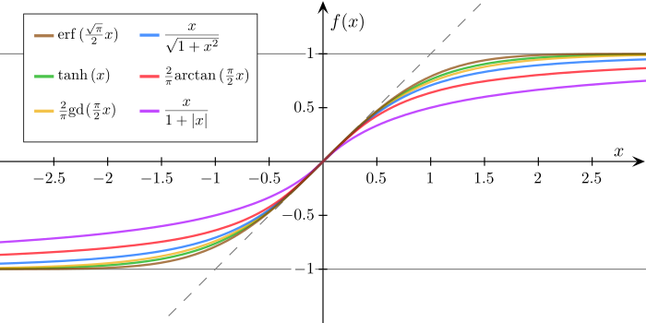
Tumour growth – Sigmoidal functions
Sigmoid functions are ‘s’ shaped curves. Broadly speaking, in vivo tumour growth can be described by them.
There are MANY different ways to produce a sigmoid!
HOW DO THESE APPLY TO CANCER?
Sigmoid functions (Wikimedia commons, Georg-Johann, 2010)

Slide 10
Tumour growth – Mendelsohn
Let’s revisit the exponential equation, but let’s modify it very slightly.
Now the rate of volume increase is proportional to the volume raised to the power of ‘b’. When b = 1, it’s just exponential. Otherwise solution is…
Here ‘C’ is just a constant related to initial conditions. For bonus exercise, you can check this equation holds. Mendelsohn and colleagues found that assuming b ~= 0.666, this model could fit a variety of tumours very well.
Any idea why this might be?
Sigmoid functions (Wikimedia commons, Georg-Johann, 2010)

Slide 11
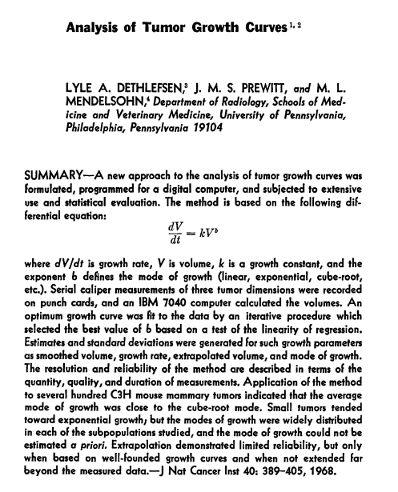
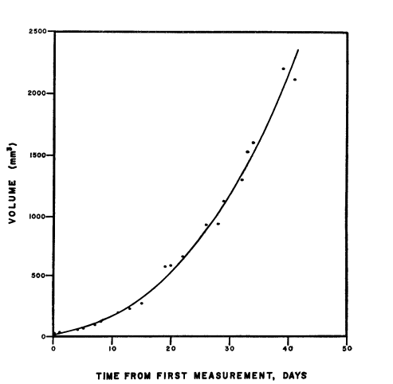
Tumour growth – Mendelsohn
The semi-empirical reasoning between b = 2/3 is essentially that growth is proportional to surface area! We’ll show this on the board now…..
It’s worth noting that this model also produces unrestrained growth. …

Slide 12
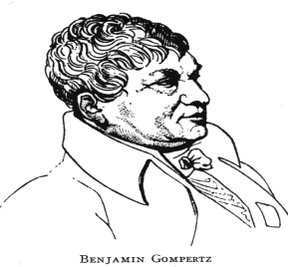
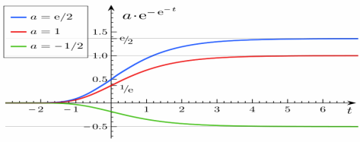
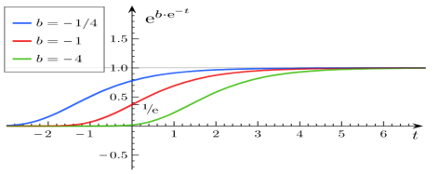
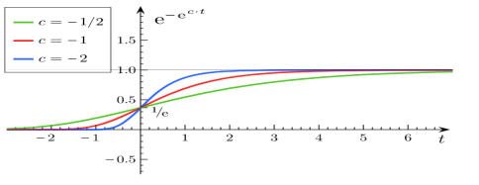
Tumour growth – Gompertzian
Mathematician Benjamin Gompertz originally put forward a curve for estimating mortality in the 1800s!
In Gompertz’s formulation, the system is essentially an exponential on top of an exponential.

Slide 13
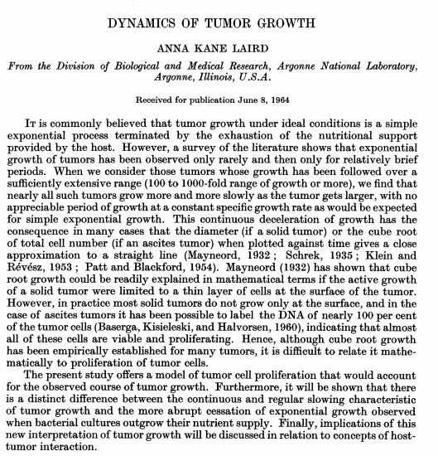
Tumour growth – Gompertzian
This was recast by Laird (1963) into a new form for tumours:
It can be shown that the maximum volume obtained is…
As an exercise, it’s trivial to show this is the case. But what this essentially means is that this growth model has a physical limit!
Anne Kane Laird gave this a physical interpretation – a decaying growth rate. This is the result of a variety of factors. When we encounter spheroids later, we shall discuss that!
This model has been successfully fit to hundreds of cell-line derived tumours, and is perhaps the most popular ‘classical’ tumour growth model.

Slide 14
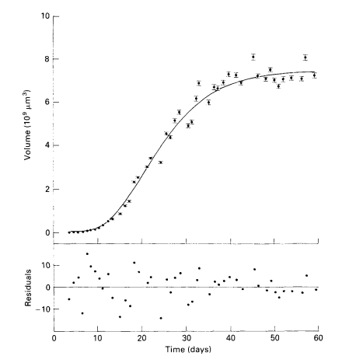
A Gompertz fit taken from Marusic et al (1994, Cell. Prolif.)

Slide 15
Tumour growth – Logistic growth
Perhaps the most well-known sigmoidal curve is the logistic function! For tumours, this is generally written as
…where K is the tumour carrying capacity. This also yields growth restraint! A little exercise in class – can we derive the form in terms V(t) ?
This version also broadly describes tumour growth well!

Slide 16
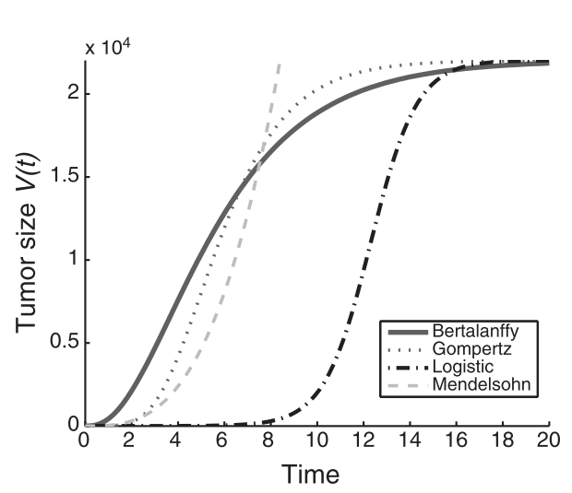
Classical tumour growth forms
There are other types of classical sigmoidal models, but we neglect them here. A more in-depth discussion can be found in Gerlee (2013).
Generally speaking, the Gompertzian model and its extensions (which we’ll briefly mention) are perhaps the most frequently encountered.
This is partially because the physical parameters needed are easy to measure, and intuitive.
For spheroids, Marsuric et al (1994) argue it is the best ‘classical’ form.
By contrast, Gerlee suggests that the inherent noise of experimental biological data shouldn’t seduce us into easiest model.
ARE THESE MODELS MECHANISTIC?
From Gerlee 2013 – The Model Muddle: In search of tumor growth laws (Cancer Res.)- An excellent review article!

Slide 17
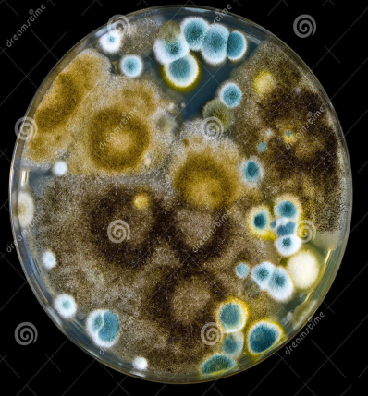
Tumour spheroids
These models all have merit and can capture the growth dynamics of different tumour lines, but they don’t specifically tell us what drives the slowing down and plateauing of growth frequently observed.
Biological reality: Consider 2D-cell culture – What issues might arise here?
AND HOW DO WE GET MORE ACCURATE?

Slide 18
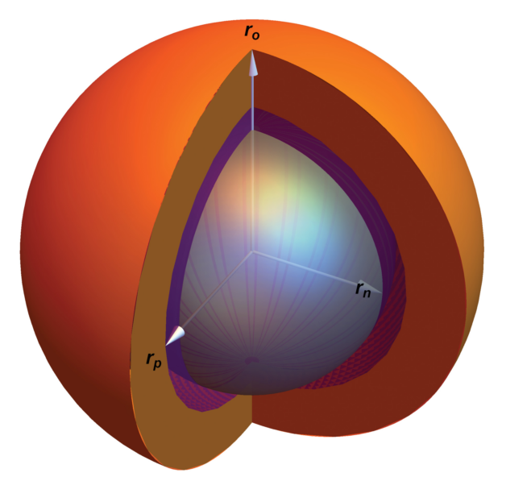
Tumour spheroids
Tumour spheroids are 3D aggregates of cells grown in a medium.
Unlike 2D cell culture, they replicate real in vivo tumours (particularly avascular types) extremely well.
They can be thought of as ‘spherical’ tumours – a nice geometry for solving!
Notably, they have heterogeneous nutrient distributions!
Essentially, this means they offer us some experimental (and theoretical) insight into the phenomena underpinning growth.
We’ll look at oxygen distribution first…..
From Grimes et al 2016 (doi:10.1371/journal. pone.0153692)

Slide 19
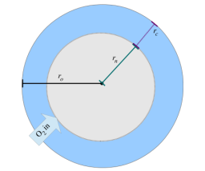
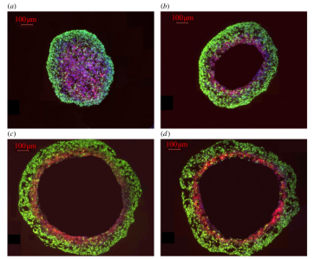
Tumour spheroids
Properties
Heterogeneous oxygen distribution.
Approximately spherical.
Tumour cells have oxygen consumption rate (OCR) of ‘a’
Oxygen diffusion constant ‘D’.
When spheroids reach a certain size, they develop a necrotic core, where the partial pressure if always zero!
No-flux condition on inner boundary.
How can we model this, and what do we find out?
Derivation is mainly in paper mentioned, but we will look at some aspects now.
Figures from Grimes et al 2014 “A method for estimating the oxygen consumption rate in multicellular tumour spheroids”, Royal Soc. Interface

Slide 20
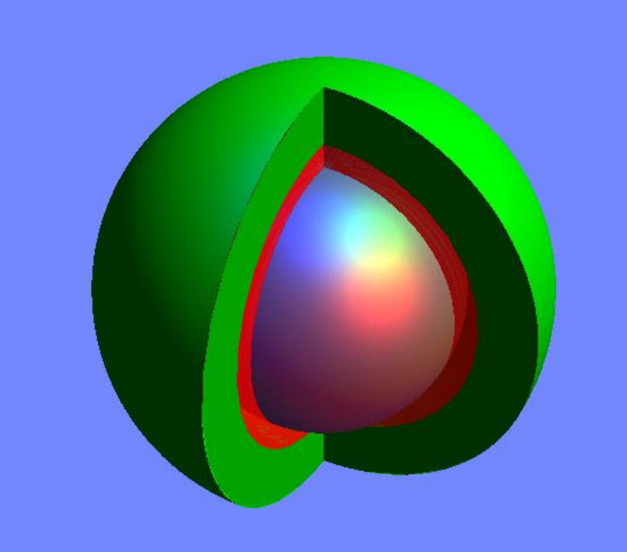
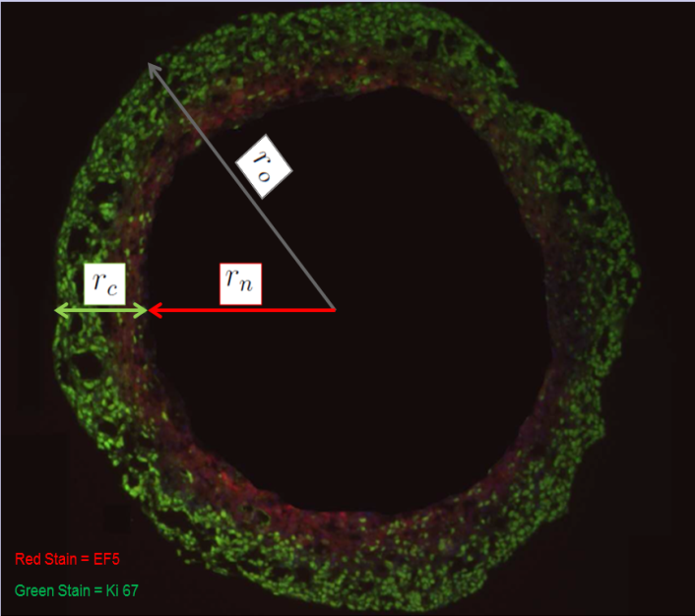
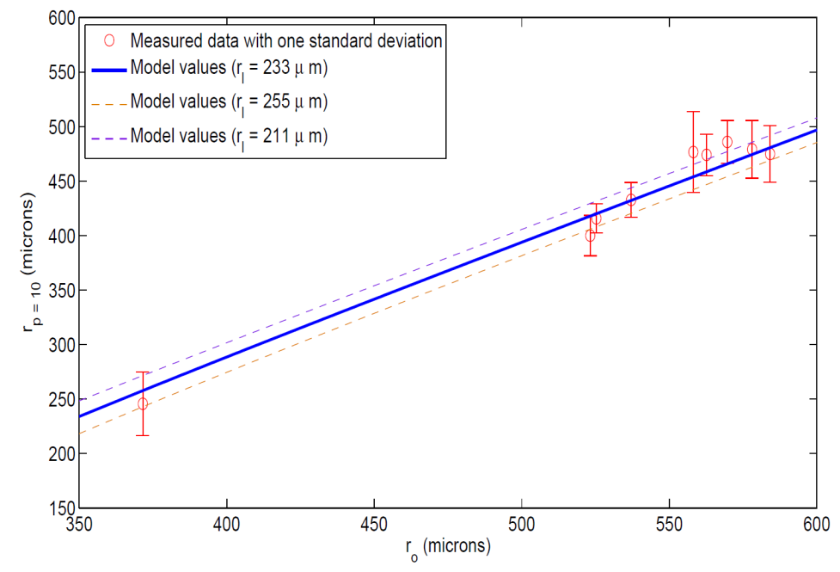
Oxygen Consumption Rate (OCR) shapes tumours
We often study spheroids, as these present a good experimental model for analysing effects of OCR & oxygen distribution in 3D!
Well
Oxygenated
Rim
After some mathematical manipulation, it’s possible to get an analytical expression for the oxygen level at any point through a spheroid:
O2 in
Anoxic
core
Importantly, the same work also allowed one to predict exactly how big the anoxic core, viable rim and hypoxic regions should be. These were found to depend heavily on oxygen consumption rate.
EF5 boundary tests (DLD1)
Figures from Grimes et al 2014 “A method for estimating the oxygen consumption rate in multicellular tumour spheroids”, Royal Soc. Interface
OCR has a huge impact on hypoxic profile

Slide 21
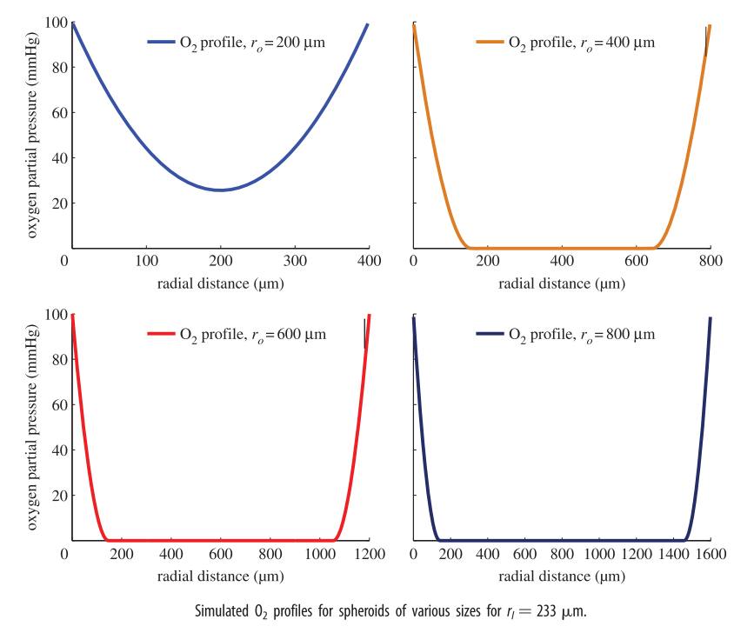
What happens to cells in the necrotic core?

Slide 22
Recap
Recalling our classical growth models from earlier, can we draw a mechanistic link between them and what is observed in spheroids?

Slide 23
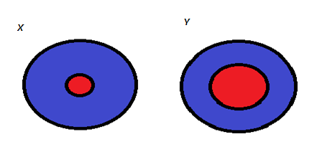
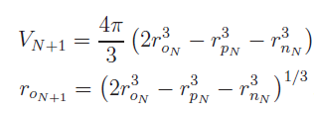
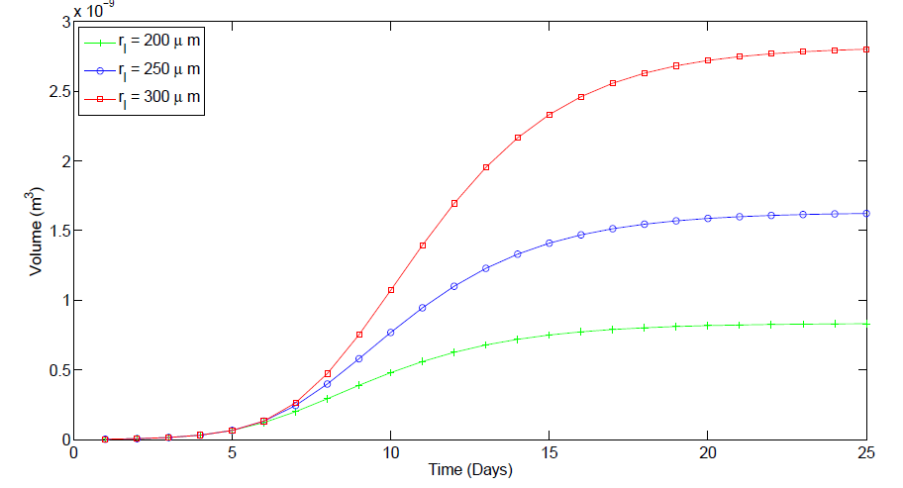
Oxygen consumption rate and tumour growth
OCR also has consequences for avascular tumour growth! OCR x << OCR y , meaning x has many more viable cells and can grow to a great extent!
Further Analysis of the mathematics shows that you can model simple spheroid growth by simple recursion!
This all suggests that in completely avascular systems, spheroids with lower OCRs should achieve a much greater plateau volume!
Lower OCR
This should depend on the average doubling time of cell line and the average OCR of the cell line.
Classic sigmoidal growth
But how do we measure OCR? We could use extracellular flux, but that doesn’t tell us the full story!
Higher OCR
Cellular Mass is required to fully quantify OCR!

Slide 24
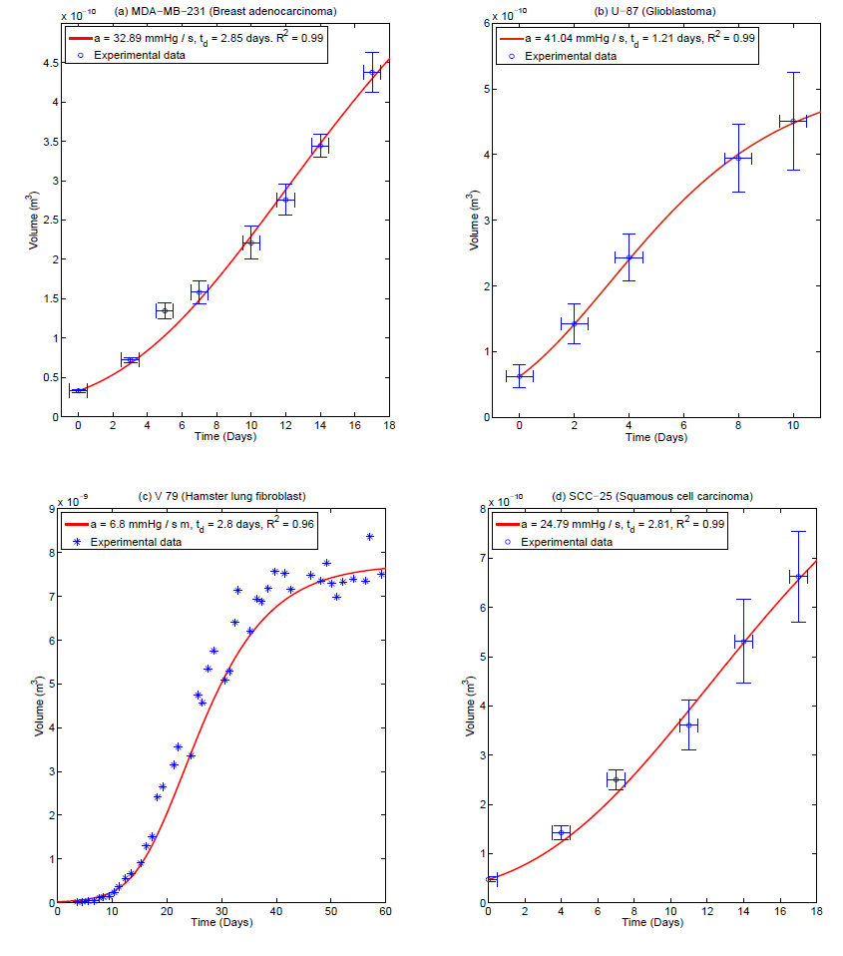
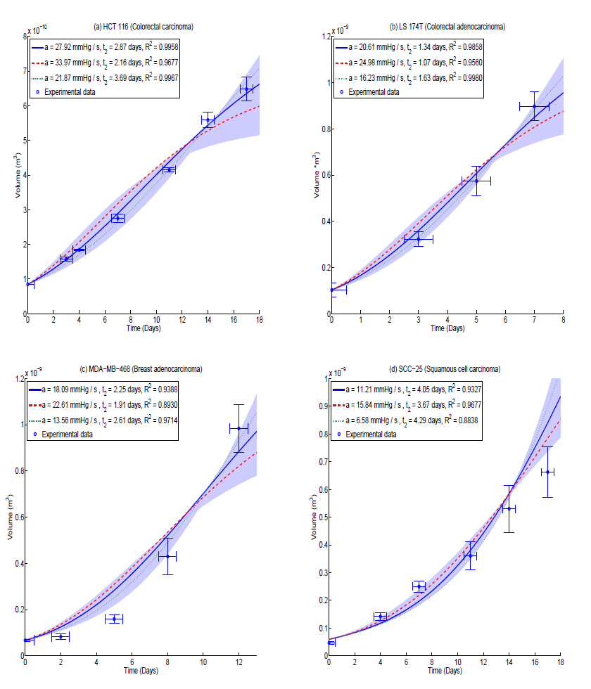
Oxygen mediated growth
Cell line | Type | SH (pM / cell x $10^{−3})$ | Estimated mass (ng) | OCR (mmHg / s )
HCT-116 | Colorectal Carcinoma | 5.37 +/- 0.13 | 2.34 +/- 0.45 | 27.92 +- 6.05
LS-174T | Colorectal adenocarcinoma | 3.59 +/- 0.10 | 2.12 +/- 0.39 | 20.61 +/- 4.38
MDA-468 | Breast Adenocarcinoma | 4.79 +/- 0.30 | 3.22 +/- 0.61 | 18.08 +/- 4.53
SCC-25 | Squamous carcinoma | 3.27 +/- 0.37 | 3.54 +/- 1.06 | 11.21 +/- 4.63
All from The role of oxygen in avascular tumor growth (Grimes et al 2016, PLOS One)

Slide 25
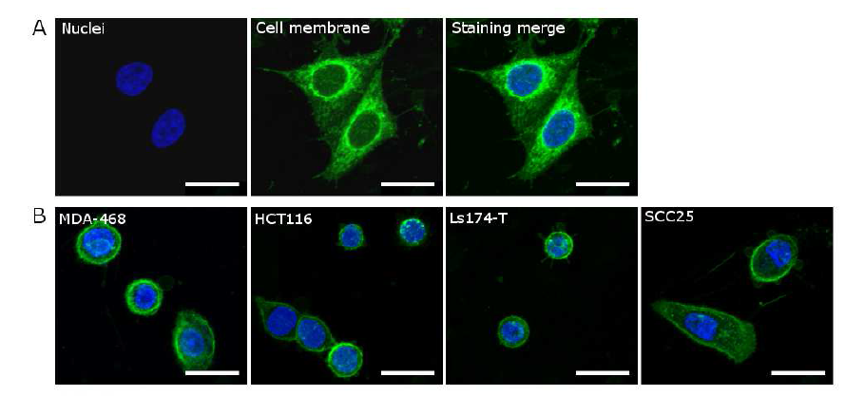
Measuring O2 consumption – Confocal method

Slide 26
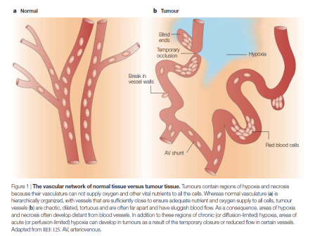
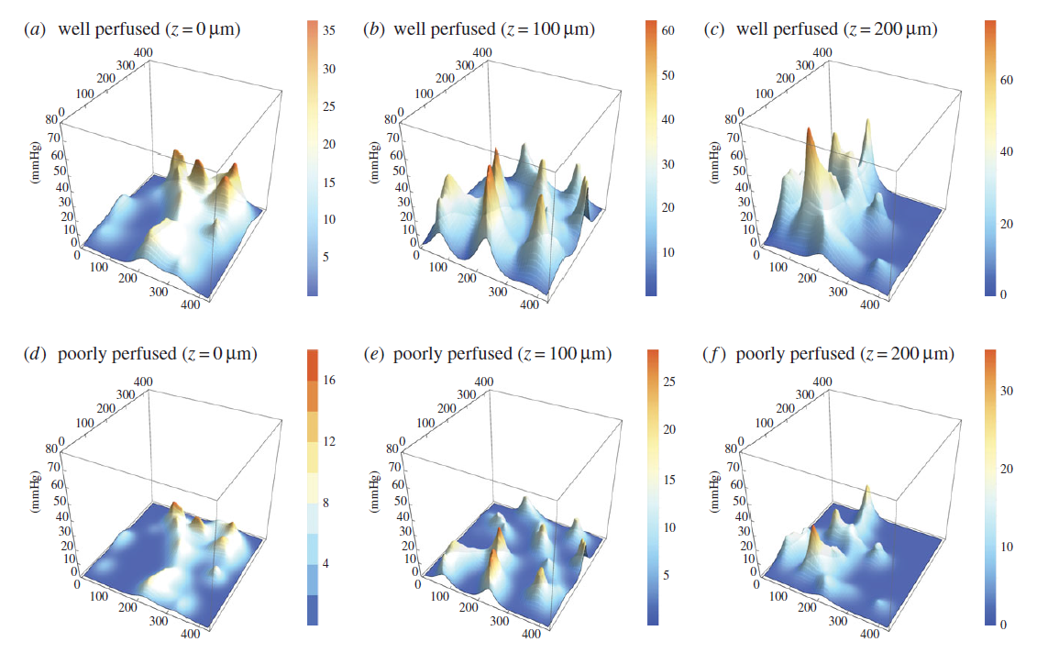
Vascular tumours
This is all very well for avascular tumours, but real in vivo tumours can recruit blood vessels and alter nutrient supply! This leads to a MUCH more complex picture.
How do we deal with such a thing? One approach is modelling the impact of vasculature and oxygen supply. We’ll touch only briefly on this for appreciation…
From Brown and Wilson 2004 - doi:10.1038/nrc1367
From Grimes et al 2016 doi: 10.1098/rsif.2016.0070

Slide 27
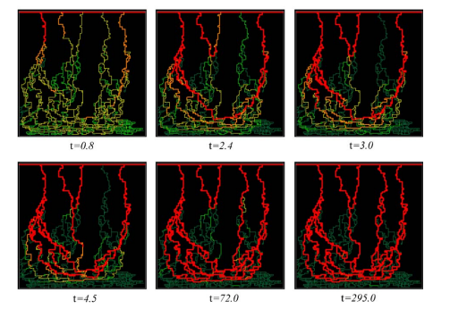
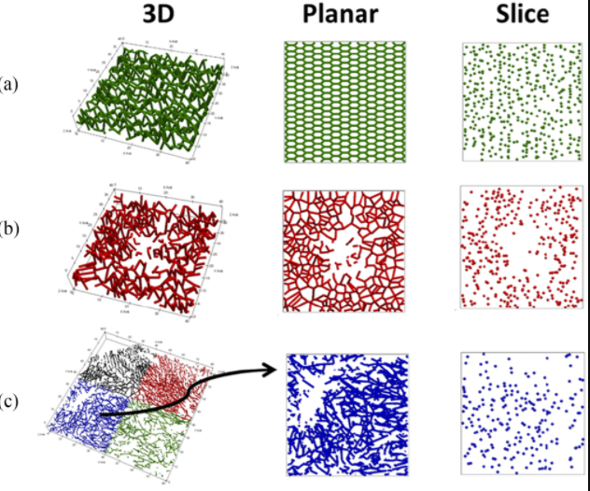
Modelling angiogenesis
Modelling angiogenic sprouting: McDougall , Anderson, Chaplain - JTB 2006
Finite element approach: Grogan et al - IEEE 2017

Slide 28
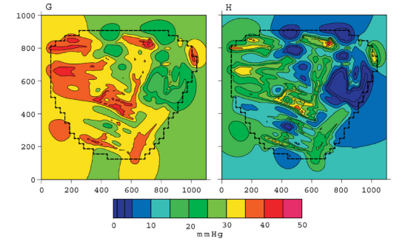
Modelling vessel oxygen supply
Green’s function method: - Secomb et al, ABE 2004
3D kernel method: Grimes et al - RSIF 2016

Slide 29
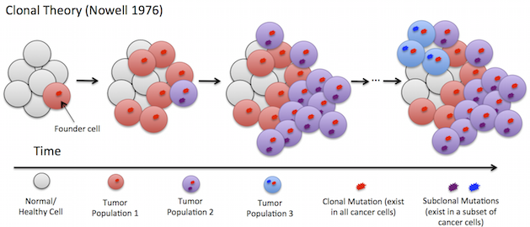
Tumour heterogeneity
Cancer cells are constantly evolving
After time, they differ quite markedly.
This means a tumour can be made up of very different types of cancer cells!

Slide 30
Tumour heterogeneity
Agent based modelling is often a useful approach to such problems!
In AGM or cellular automata, individual units are given simple computational rules.
This is useful for studying systems when cell phenotype matters.
These rules can unleash very complex behaviour!
Conway’s game of life

Slide 31
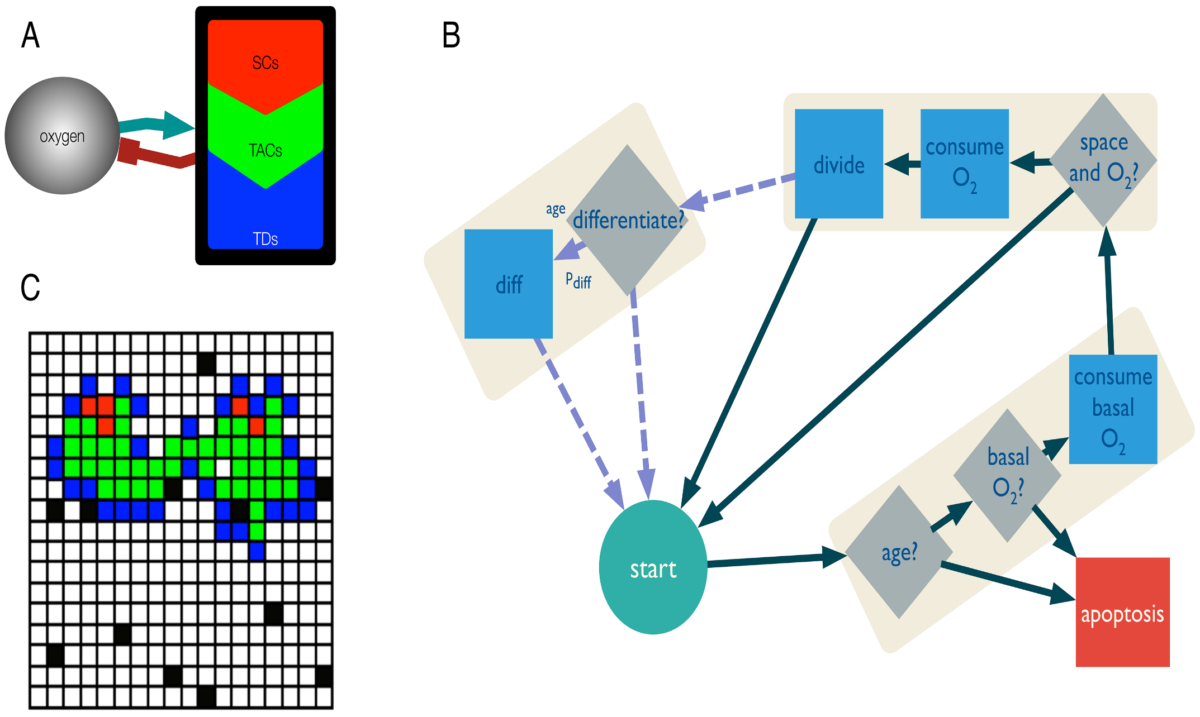
This example of a CA-type model is from Scott et al (2014, Plos Comp Bio) and includes 3 different cell types: stem (red), progenitor (green) and differentiated (black). All these cells need oxygen, and behaviour of each cell type is captured by a flowchart (last segment with discontinuous arrows represents behaviour specific to the stem cells). Black points are oxygen sources!

Slide 32
AN EXAMPLE FROM CAIRR WORK…

Slide 33
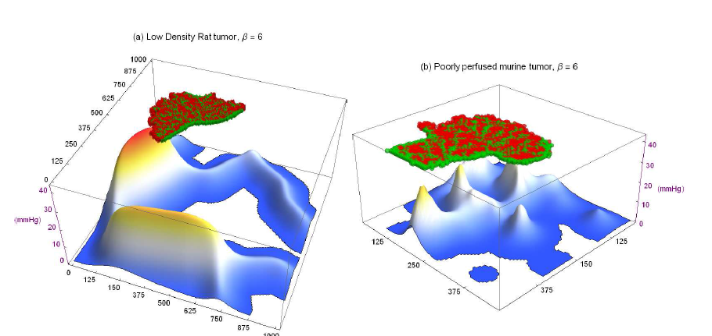

Slide 34
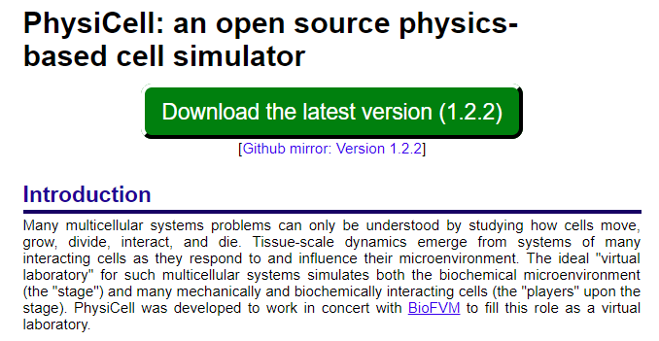
More on ABMs
ABMs can also replicate real physical interactions between agents.
An example if the Macklin lab’s ‘Physicell’, which encodes physical rules about cell interactions to yield complex behaviour
What is a hybrid model?

Slide 36
Tumour modelling
There are hundreds of different types of tumour models, encompassing everything from intercellular dynamics right up to growth models.
In this course, we’ve got a brief over-view of some aspects of tumour modelling.
What is striking is quite how many avenues there are to explore, and how many approaches.
We’ve touched on classical ODE growth models, microenvironmental models, mechanistic models, agent-based models and hybrid models.
We’ve also got some insight into the difference between mechanistic and phenomenological models. Sometimes, we end up using a combination of both!
As physicists, we should also think about validation / falsification – let’s discuss that now.
Tumour models ideally give us some insight into the nature of cancer – and now avenues for treating and understanding it.
QUESTIONS / DISCUSSION

